Slide 1


Testing. What if it was a sexy business?
Antti Niittyviita, @niittyviita
prove.fi, testiatarantula.com

Slide 2
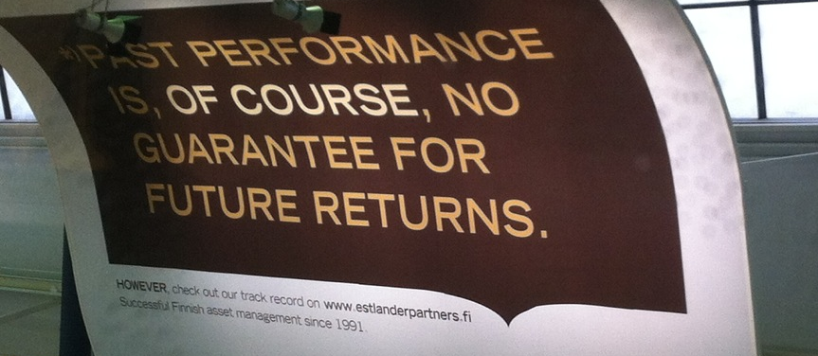

Slide 3
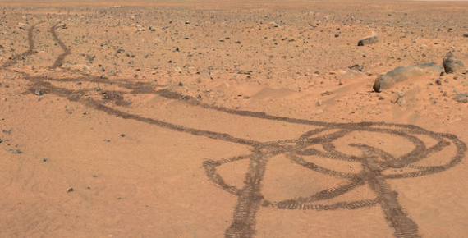

Slide 4
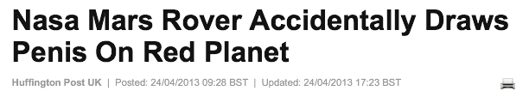

Slide 5
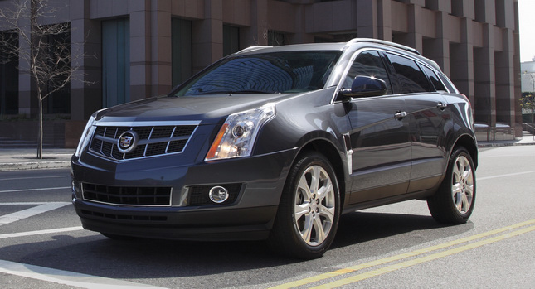

Slide 6


Slide 7


Slide 8


Slide 9
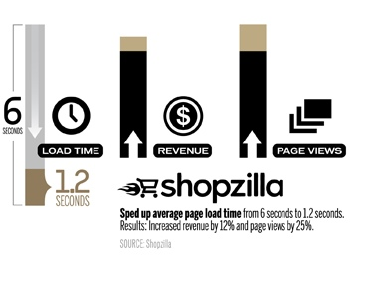

Slide 10
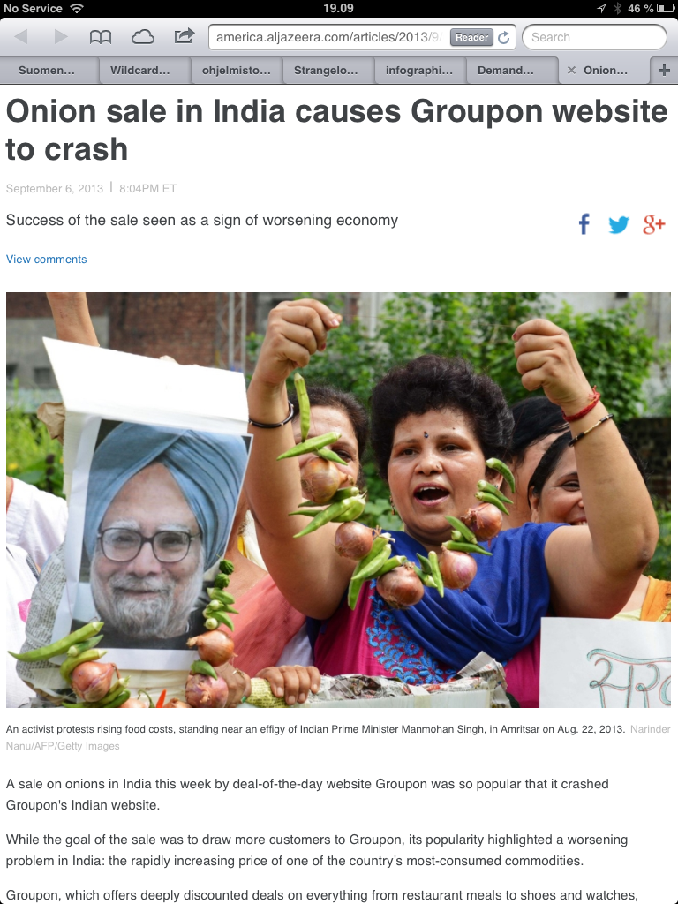

Slide 12
But how does it make testing a sexy business?!

Slide 13


Slide 14
Keep your eyes open
Learn the stories
Dollarize

Slide 15


